Slide 1




Software requirement specification For Bus Rapid Transit Application presentation

Slide 2
BRT Vision Statement
For those who want to avail the bus service of red, blue, green, and orange lines through the application, the BRT service is an online application that will allow the registered users to book and cancel the ride, find the routes and the timing of bus, look all the location of buses through Google maps, get notification when the bus approaches their stops, avail discount offers, complain, and pays online through Easy-paisa, Jazz-Cash, BRT premium card and through bank transaction. Unlike the manual system, customers need to queue up in a long queue to buy the bus ticket and ask for information and this brings a lot of inconvenience to customers, the conductor does not need to take fare by approaching each person on the bus, and the users do not require to stand and wait for the bus for 30 to 40 minutes at the bus stop, the BRT service permits the user to pay through the online transaction and scanning the card and book the ride for them and view the location of the bus and also notify them when the bus reaches to their stop.

Slide 3
Project justification:
Currently, about 17 million registered motor vehicles are in Pakistan . It is expected to surpass 30 million by 2025. Demand for oil consumption in the transport sector will also increase accordingly by 2025, which at present is about 302 thousand barrels per day. Over the last few years, Pakistan witnessed only a small increase in domestic oil production. Thus has to rely increasingly on imports to meet domestic requirements. The main objective of the application is to save the economy by reducing the use of private transport from 77% to 27% in the city by providing the people of Karachi with a better bus service with various facilities. Therefore, by increasing the use of public transport petroleum consumption could be reduced.

Slide 4
Important Functional Requirement
Registration:
Online registration is provided to the passengers to register themselves .
In registration form passengers fill the details : name, CNIC, registered phone number, email address and password, Area and city .
For Bus Interface:
System shall provide four interfaces for 4 types of buses such as Red, blue , green and Orange.
For all buses ,there is an option for book ride through which passenger can book his ride by entering destination and pick up station.
If the user book ride , he can see the available seats.
Without booking a ride , users can easily see the schedule of buses when they start and stop with mentioned routes.
User can see the location of bus through Google map .
Settings:
Edit profile option will available for passengers for editing if they want changes.
Passenger pay for ticket online from wallet option.
Wallet recharge option is available for users to recharge easily.

Slide 5
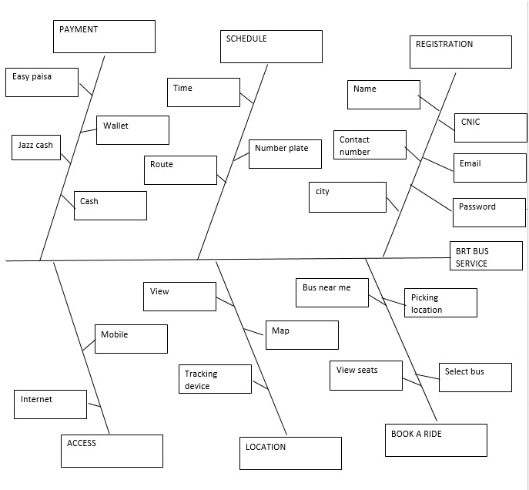
Feature diagram

Slide 6
Important Non-Functional Requirements
Usability:
User can pay for ticket online through different modes like: jazz cash, easy paisa and through credit card.
Sort and filters options are available for user preferences.
Efficiency:
Performance
App is open within a second.
Notifications and reminders for users pop up before bus reaches on the stop.
Space:
This online BRT system app easily download in just 46MBs.
This system take Arduino kind of servers.
Reliability:
Book ride option book passenger’s ride and also cancel the ride through cancel button.
Through registration user will be registered.
Google map options user can view the different buses by their representation, available seats and booked seats.
User pay for their ticket and recharge wallet through wallet option.
Portability:
Users can use this app online on android, iPhone.

Slide 7
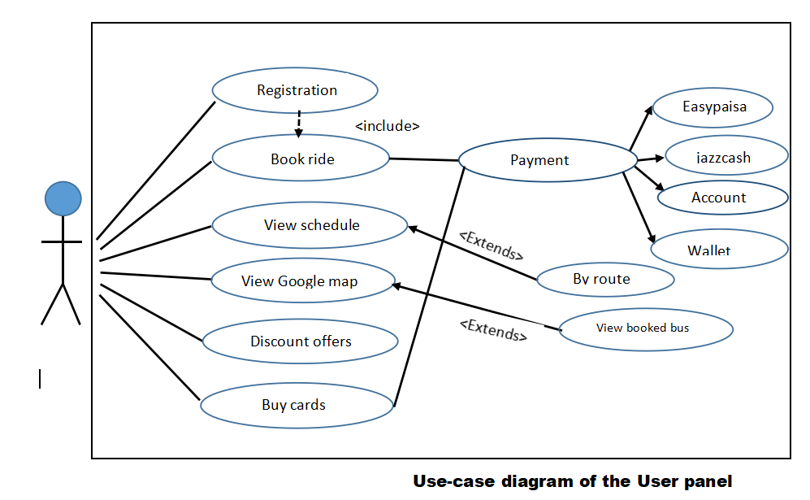

Slide 8
User Interfaces
Main Interface
This interface is mainly about selecting a bus. This interface will split up into four sub-interfaces such as a separated interface for Red bus, a separated interface for Green bus, a separated interface for Blue bus, a separated interface for Orange bus.
Sub-interfaces for Buses
All the Sub-interfaces of the buses shall have the similar features where a user can see the timings\schedule for the arrival of the bus, driver’s information, Bus number etc. In this interface the user can book a ride after entering their destination.
Payment Interface
This interface will enable users to select a payment method such as bank transfer, mobile banking options will also be available like jazz cash, easy-paisa etc. Users shall also be able to pay through the inbuilt wallet of the BRT application or use their premium card for booking the ride. This interface will also provide the feature of recharging the wallet or purchase of a premium card to the user.

Slide 9
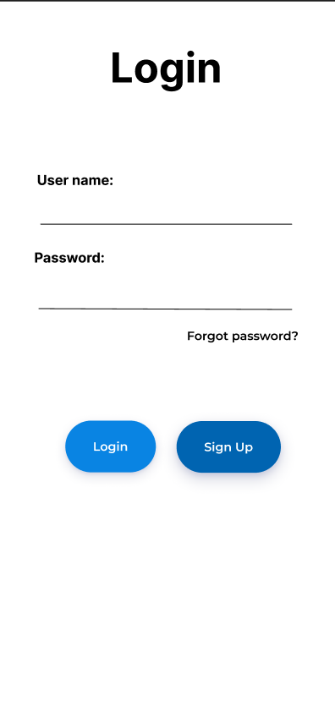
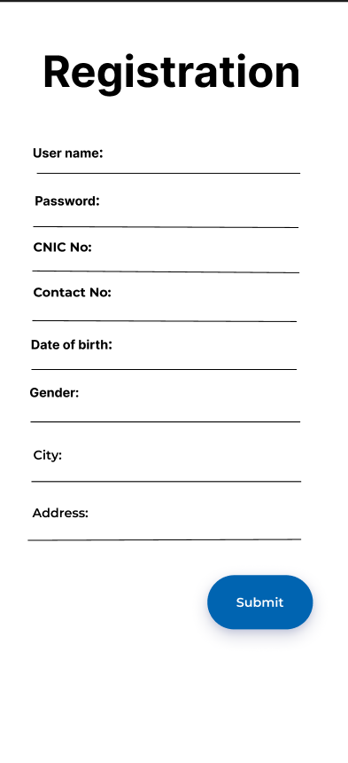
Story Boarding for BRT Application

Slide 10
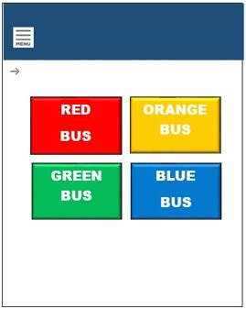
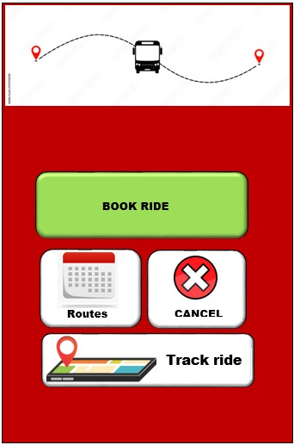
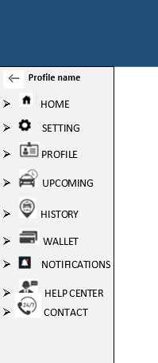

Slide 11
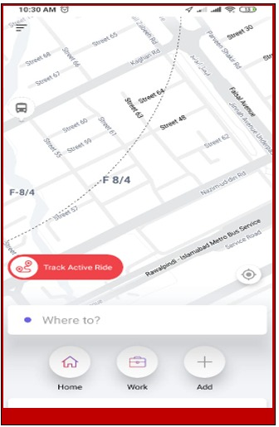
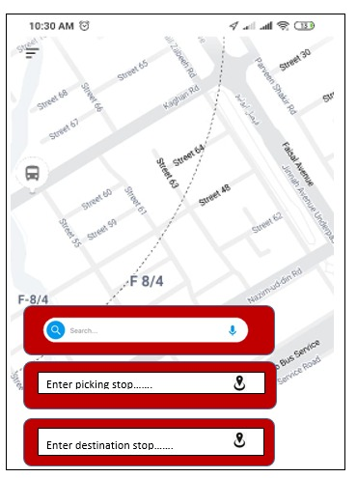
Track a ride
Select pick and drop location

Slide 12
Business Rules:
Fact
Only one account can be made on one CNIC.
Action Enabler
In case of a strike, mail will be sent to all the registered users.
Constraint
The user cannot cancel a ride after 15 minutes of booking.
Interference
If a user canceled a ride more than 2 times a week, he will be considered a weak customer.
Computation
The total fare will be calculated at the end by multiplying the number of seats the passenger has book, and additional charges will be added as well.

Slide 13
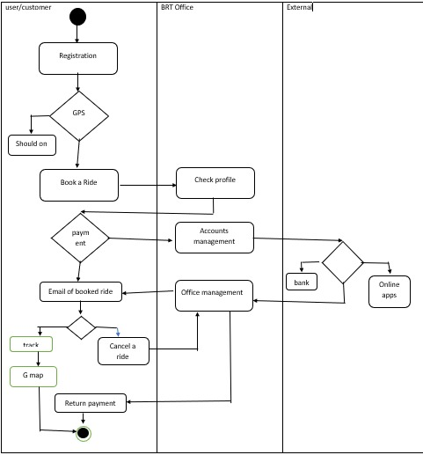
Swim Lane

Slide 14
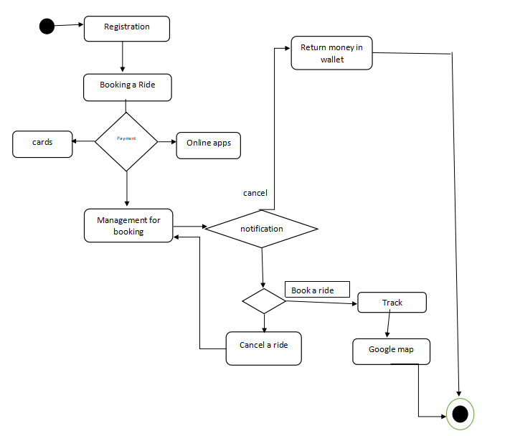
State Transition Diagram

Slide 15

Operating environment:
The BRT application is an online mobile phone application and shall operate on all android phones, tablets, iPads, and iPhones that have an active internet connection and have at least 2 GB RAM.

Slide 16
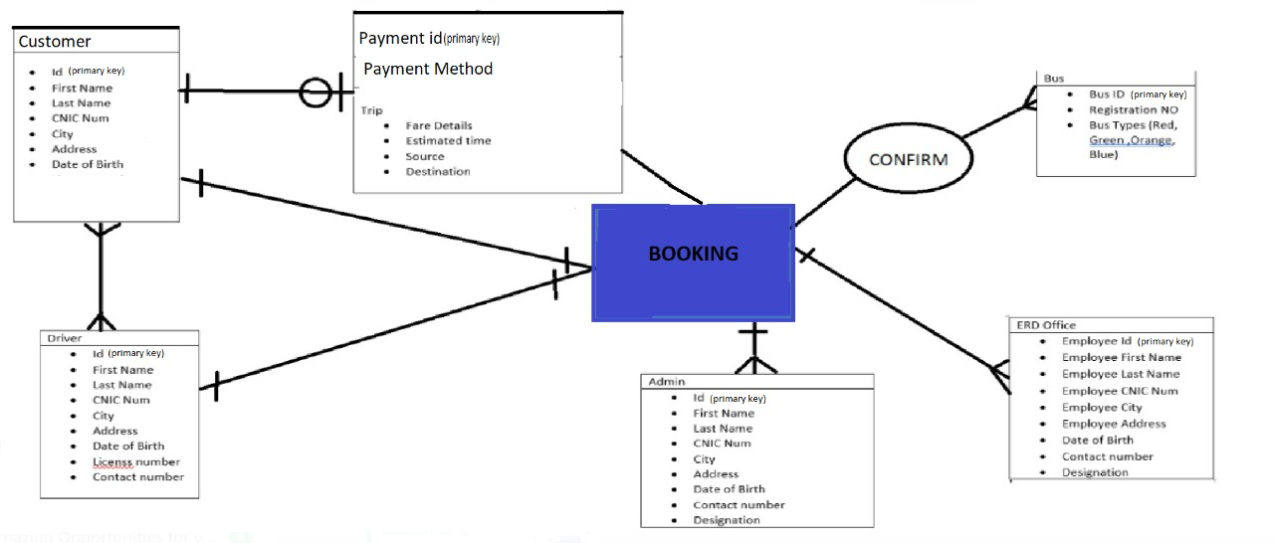

Slide 17
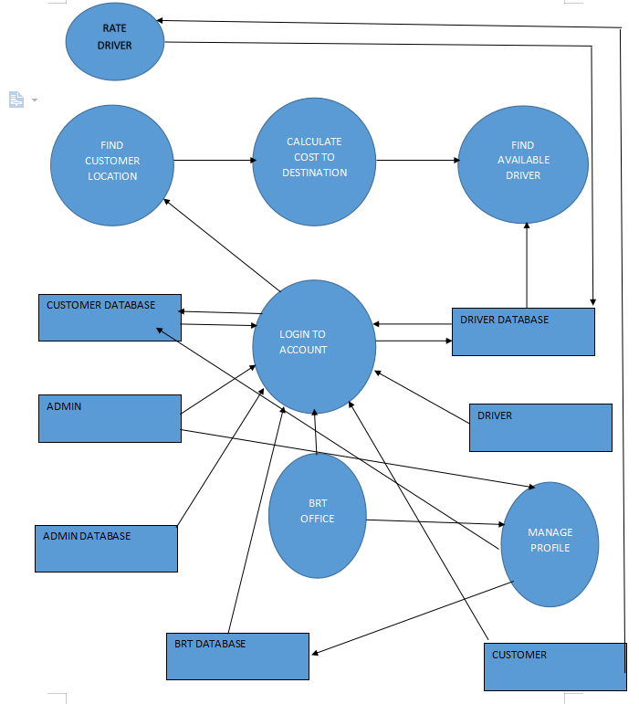
DATA FLOW DIAGRAM

